Slide 1
Morning session: overview
Unsupervised learning: dimension reduction and data integration
Principal Component Analysis (PCA)
Maximal variance principle
Partial Least Squares (PLS)
Maximal covariance principle
Two-way Orthogonal PLS (O2PLS)
Multi-omics data integration

Slide 2

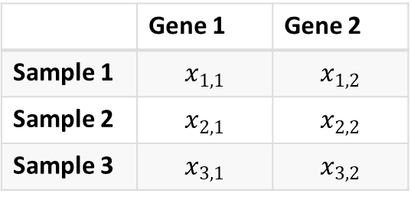
Introduction
Suppose we have a dataset $X$, with $N$ rows and $p$ columns
Make it concrete: gene expression values, metabolite abundances, questionnaires, etc
How to inspect these variables and their correlations?
 | Gene 1 | Gene 2
Sample 1 | $$x_{1,1}$$ | $$x_{1,2}$$
Sample 2 | $$x_{2,1}$$ | $$x_{2,2}$$
Sample 3 | $$x_{3,1}$$ | $$x_{3,2}$$

Slide 3
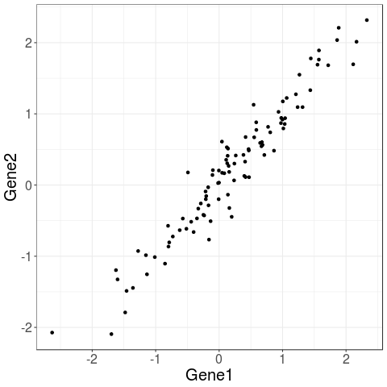
Example: bivariate data
Suppose we have two genes
They are highly correlated
How would you represent these data? Do you need both dimensions?
In general, aggregate data across direction of maximal variance

Slide 4
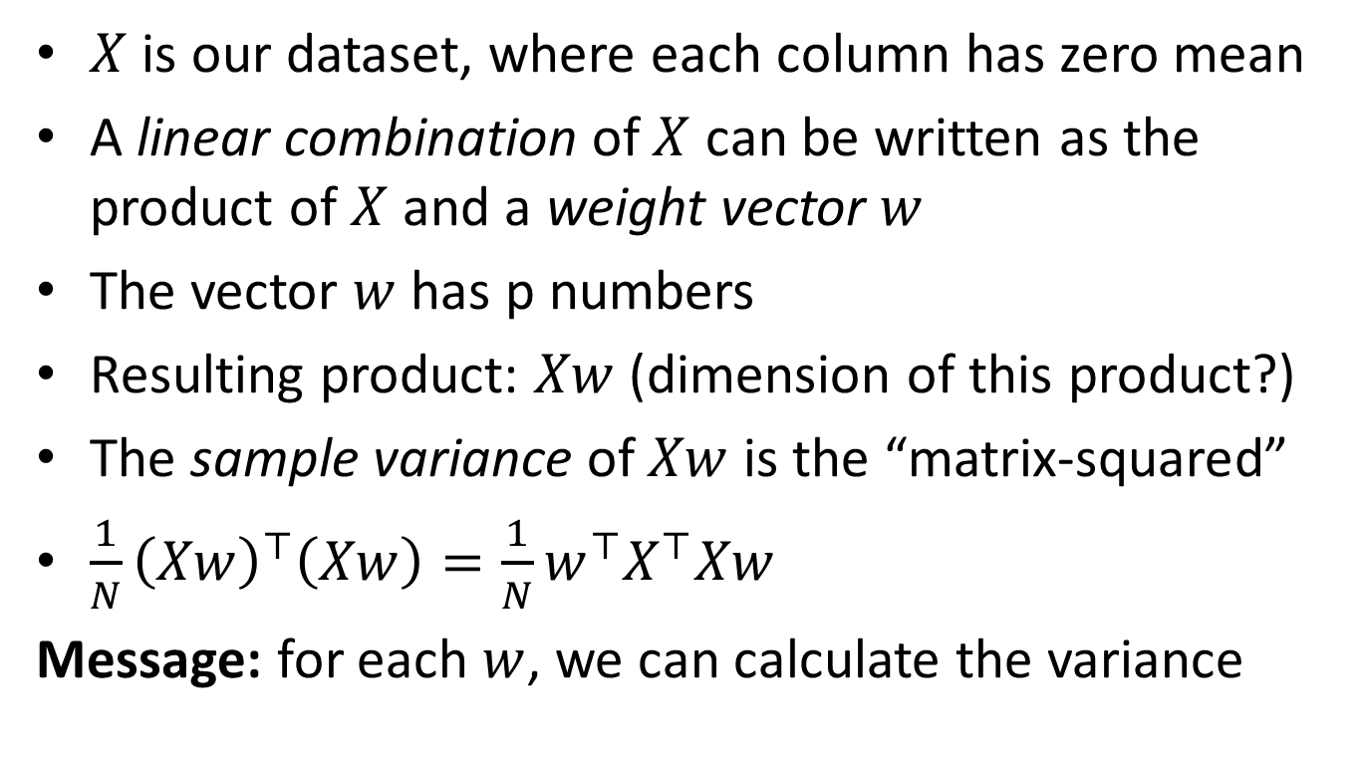
PCA principle: maximal variance
$X$ is our dataset, where each column has zero mean
A linear combination of $X$ can be written as the product of $X$ and a weight vector $w$
The vector $w$ has p numbers
Resulting product: $Xw$ (dimension of this product?)
The sample variance of $Xw$ is the “matrix-squared”
$\frac{1}{N}{\left(Xw\right)}^{⊤}\left(Xw\right)=\frac{1}{N}w^{⊤}X^{⊤}Xw$
Message: for each $w$, we can calculate the variance

Slide 5
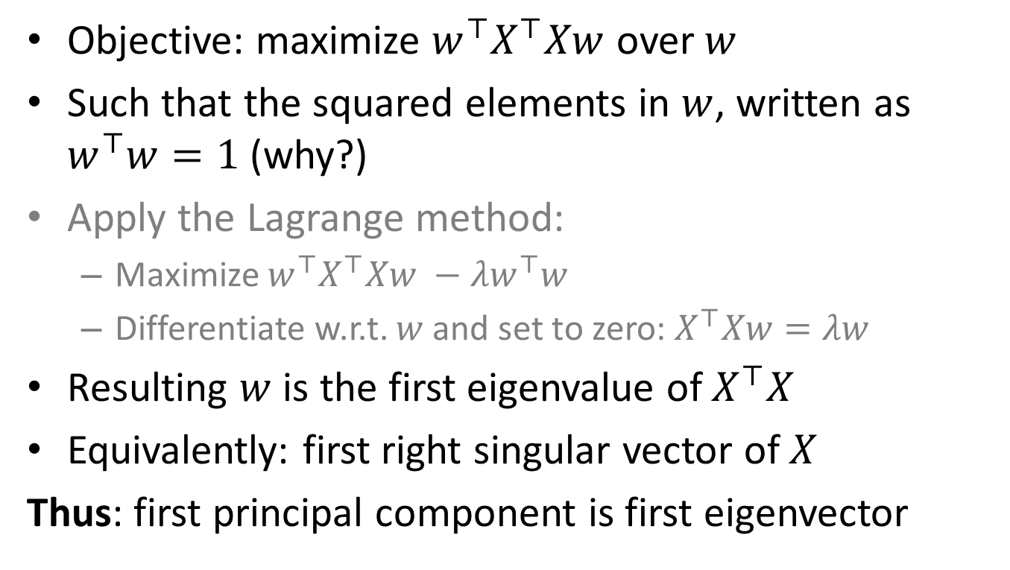
PCA algorithm: estimation
Objective: maximize $w^{⊤}X^{⊤}Xw$ over $w$
Such that the squared elements in $w$, written as $w^{⊤}w=1$ (why?)
Apply the Lagrange method:
Maximize $w^{⊤}X^{⊤}Xw −λw^{⊤}w$
Differentiate w.r.t. $w$ and set to zero: $X^{⊤}Xw=λw$
Resulting $w$ is the first eigenvalue of $X^{⊤}X$
Equivalently: first right singular vector of $X$
Thus: first principal component is first eigenvector

Slide 6
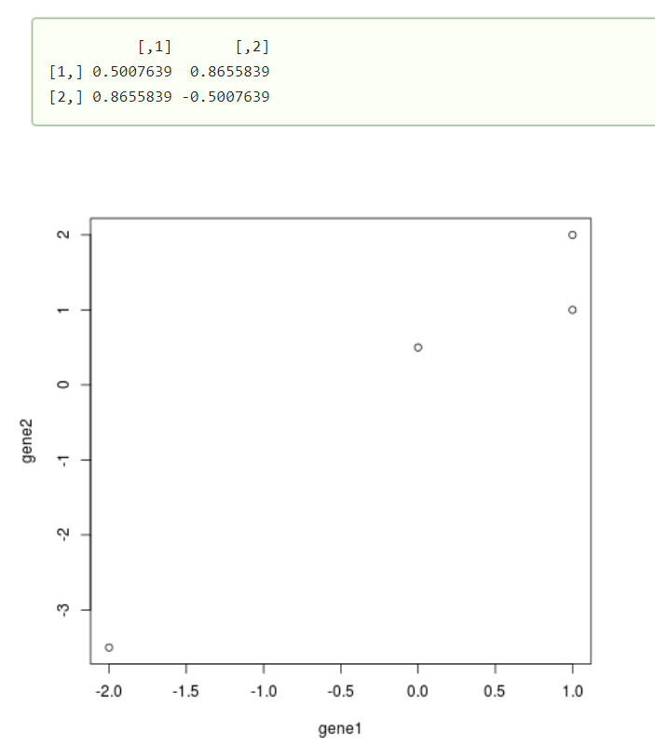
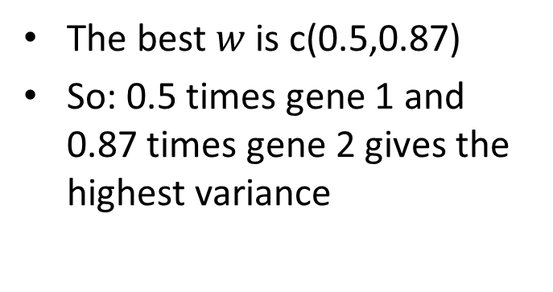
An example in R
gene1 <- c(-2, 0, 1, 1)
gene2 <- c(-3.5, 0.5, 2, 1)
plot(gene1, gene2)
svd(cbind(gene1, gene2))$v
The best $w$ is c(0.5,0.87)
So: 0.5 times gene 1 and 0.87 times gene 2 gives the highest variance

Slide 7
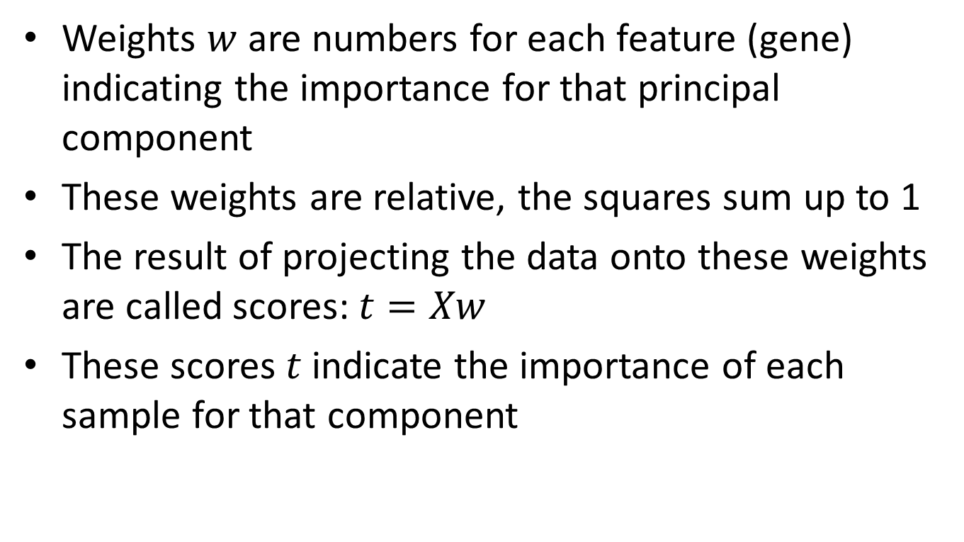
PCA: interpretation of the results
Weights $w$ are numbers for each feature (gene) indicating the importance for that principal component
These weights are relative, the squares sum up to 1
The result of projecting the data onto these weights are called scores: $t=Xw$
These scores $t$ indicate the importance of each sample for that component

Slide 8
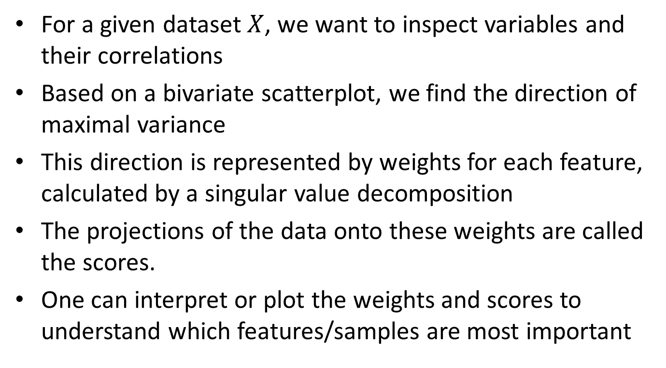
Principal component analysis: summary
For a given dataset $X$, we want to inspect variables and their correlations
Based on a bivariate scatterplot, we find the direction of maximal variance
This direction is represented by weights for each feature, calculated by a singular value decomposition
The projections of the data onto these weights are called the scores.
One can interpret or plot the weights and scores to understand which features/samples are most important

Slide 9
Morning session: overview
Unsupervised learning: dimension reduction and data integration
Principal Component Analysis (PCA)
Maximal variance principle
Partial Least Squares (PLS)
Maximal covariance principle
Two-way Orthogonal PLS (O2PLS)
Multi-omics data integration

